Slide 1
Multivariable Statistical Methods
Regression Analysis of the Strength of Concrete

Slide 2
Data Data Data
A little explanation and exploration
This dataset was selected from the UCI Repository.
It contains 1030 variations of different mixtures of 7 Inputs
Out of the 7 inputs, 6 of the inputs are each in kg/m^3
The 7th input is the ’Age’ of the cement in no. of days
The output is the strength of compressive concrete cement in MPa
There seem to be no null values aka missing values in the dataset

Slide 3
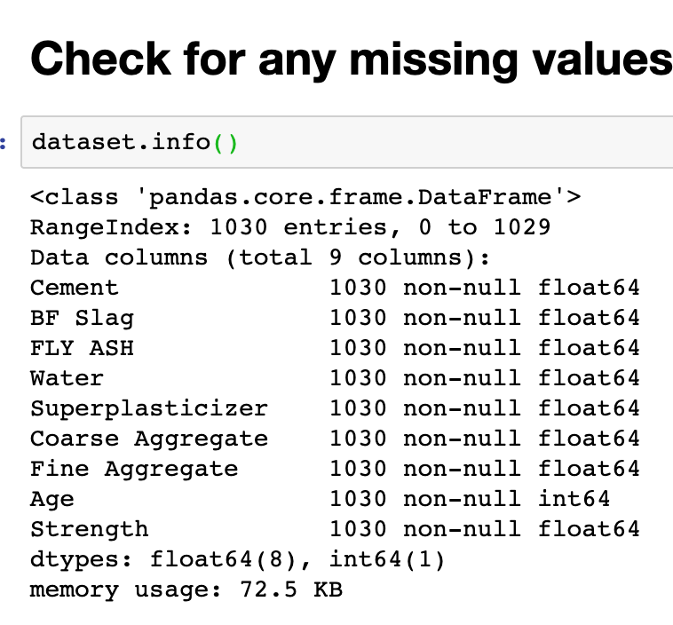
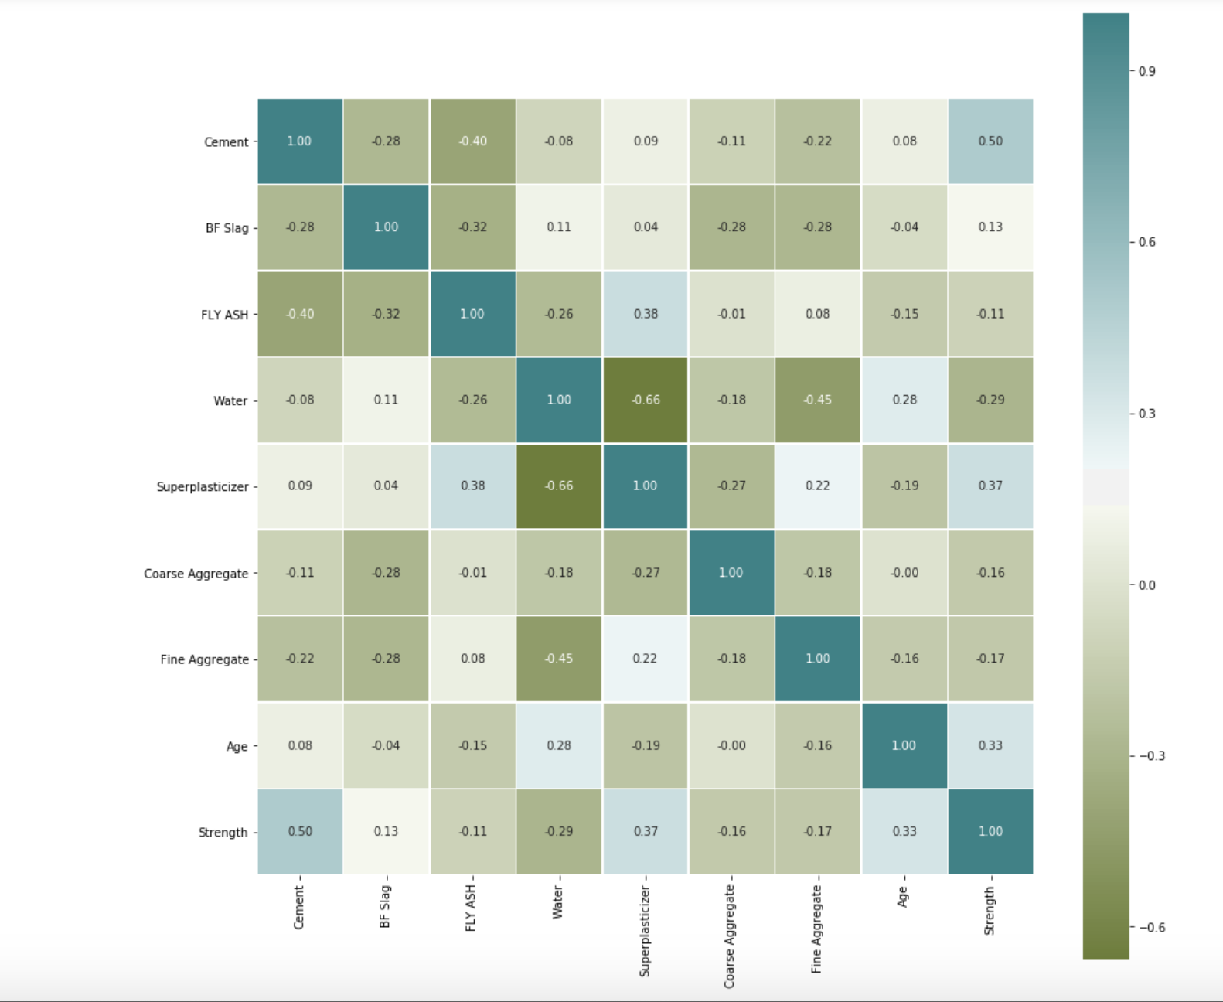
Exploring The Data

Slide 4
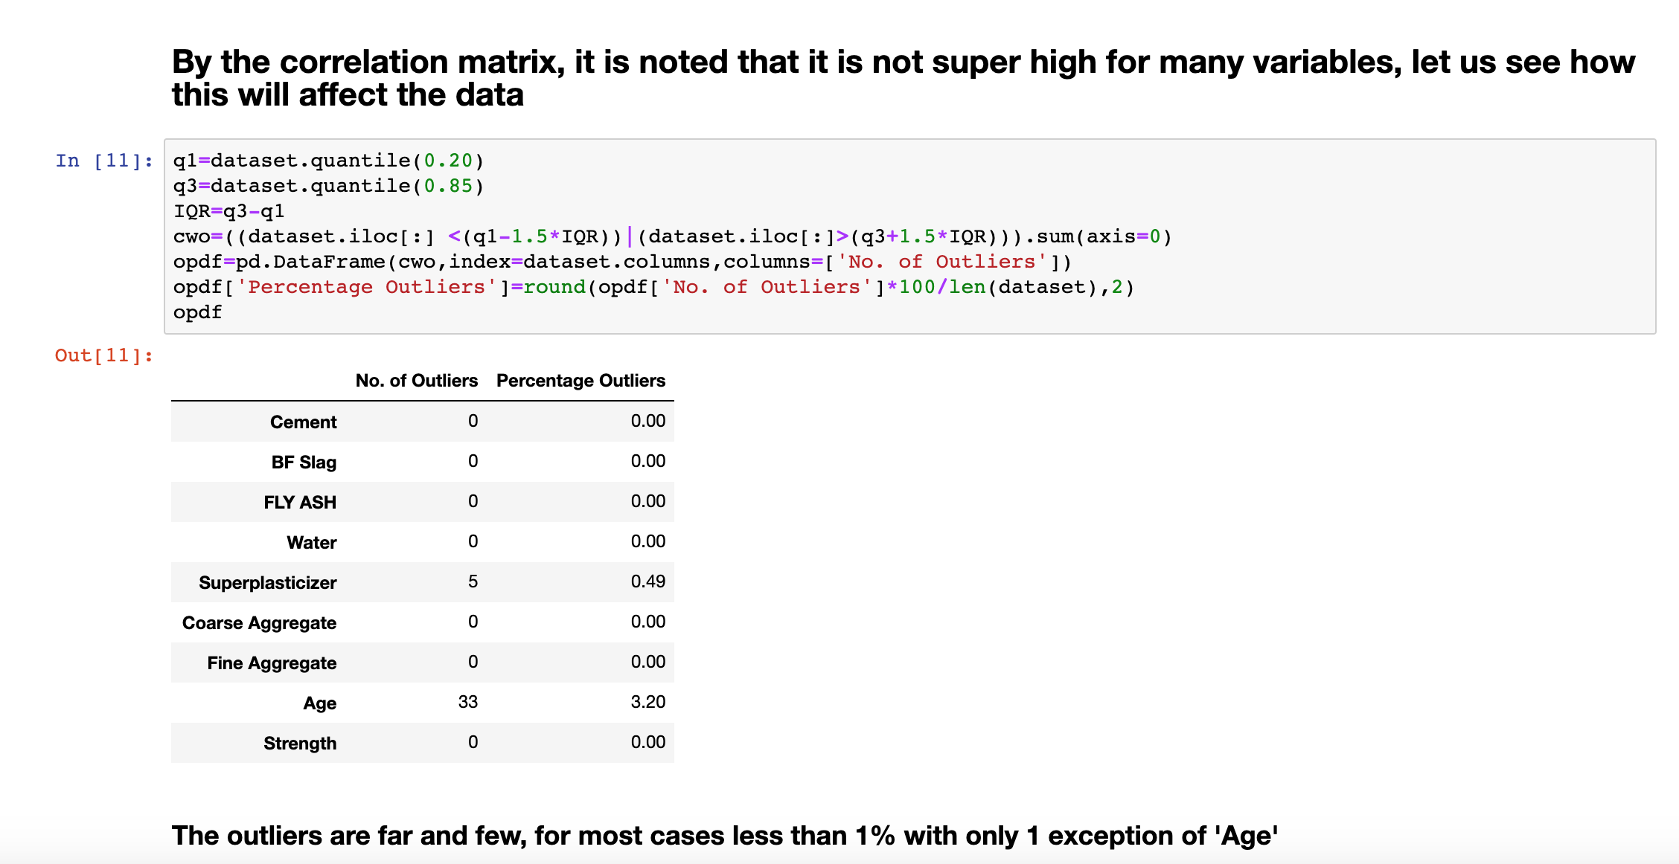

Slide 5
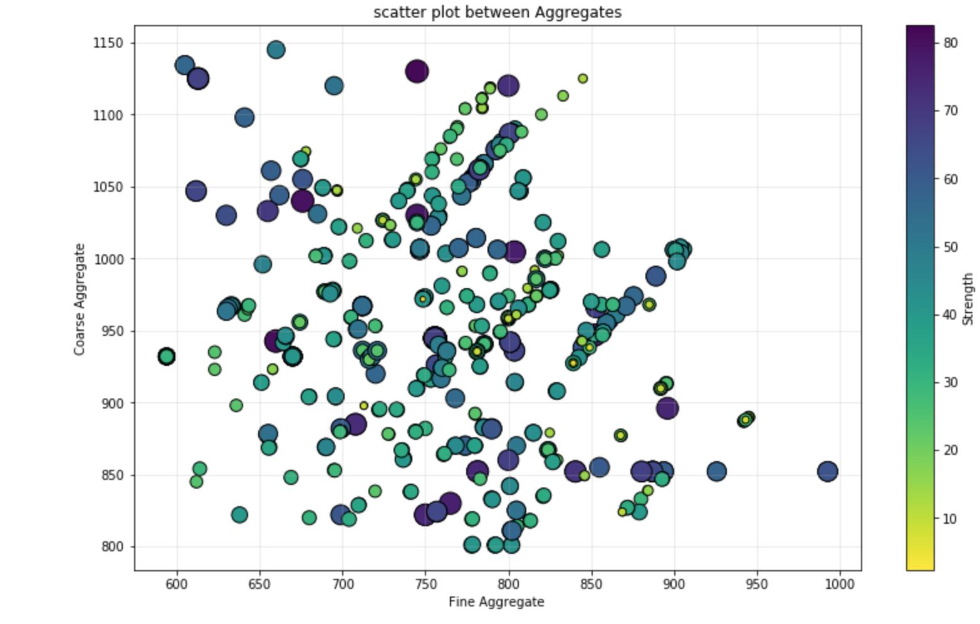
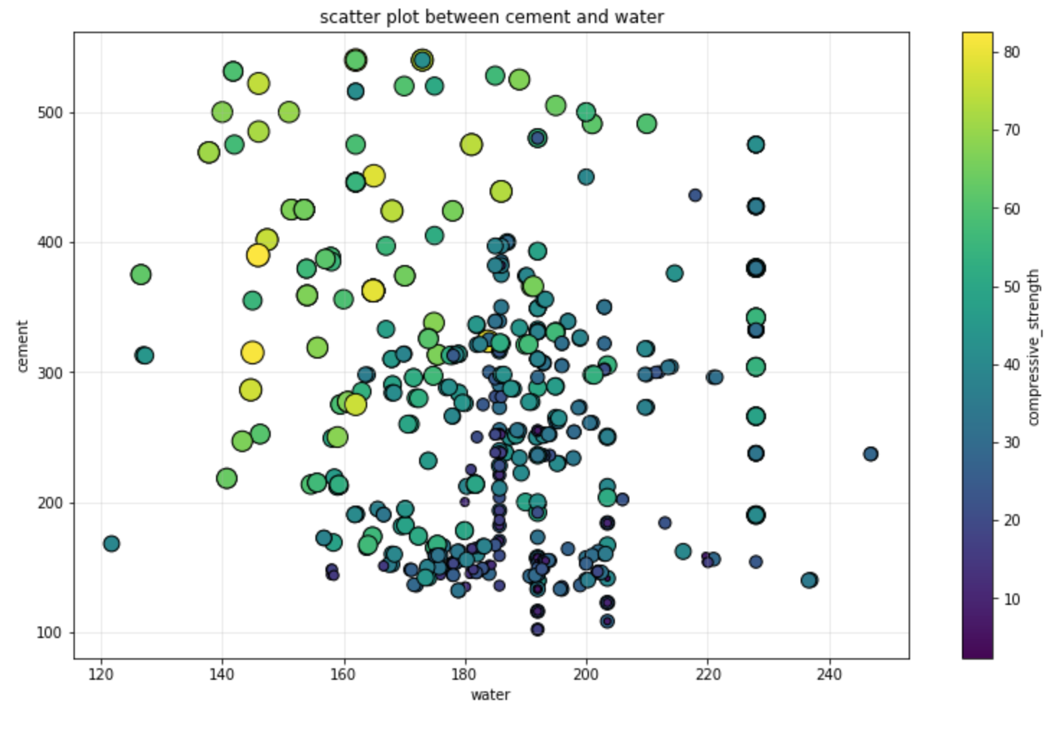
Scatter plots indicating weights and some insights

Slide 6
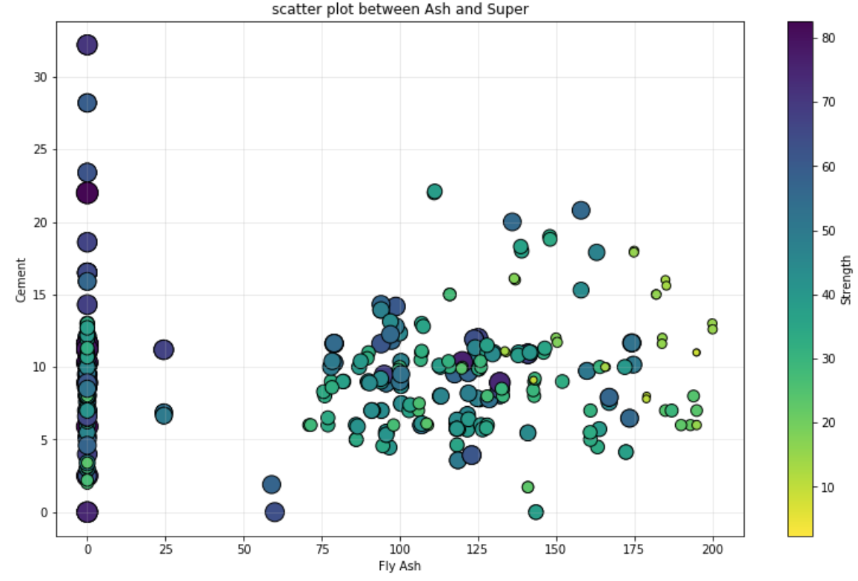
Ash vs Superplasticizer

Slide 7
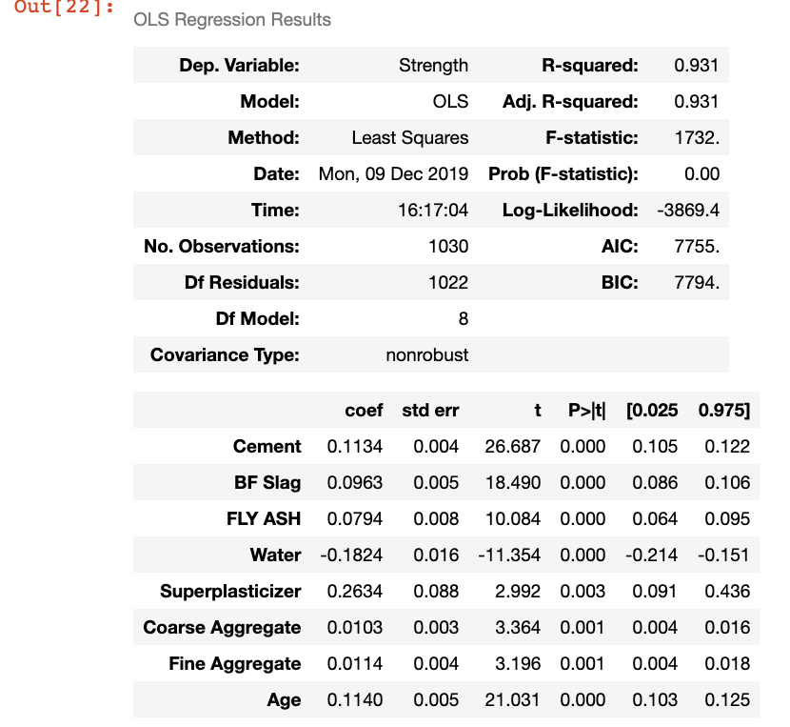
Ordinary Least Squares (OLS)
I am trying to find a relationship between the dependent and independent variables.
This was one of my better predictors of how much of the data was explained in my regression.
The coefficient for each explanatory variable reflects both the strength and type of relationship the explanatory variable has to the dependent variable.

Slide 8
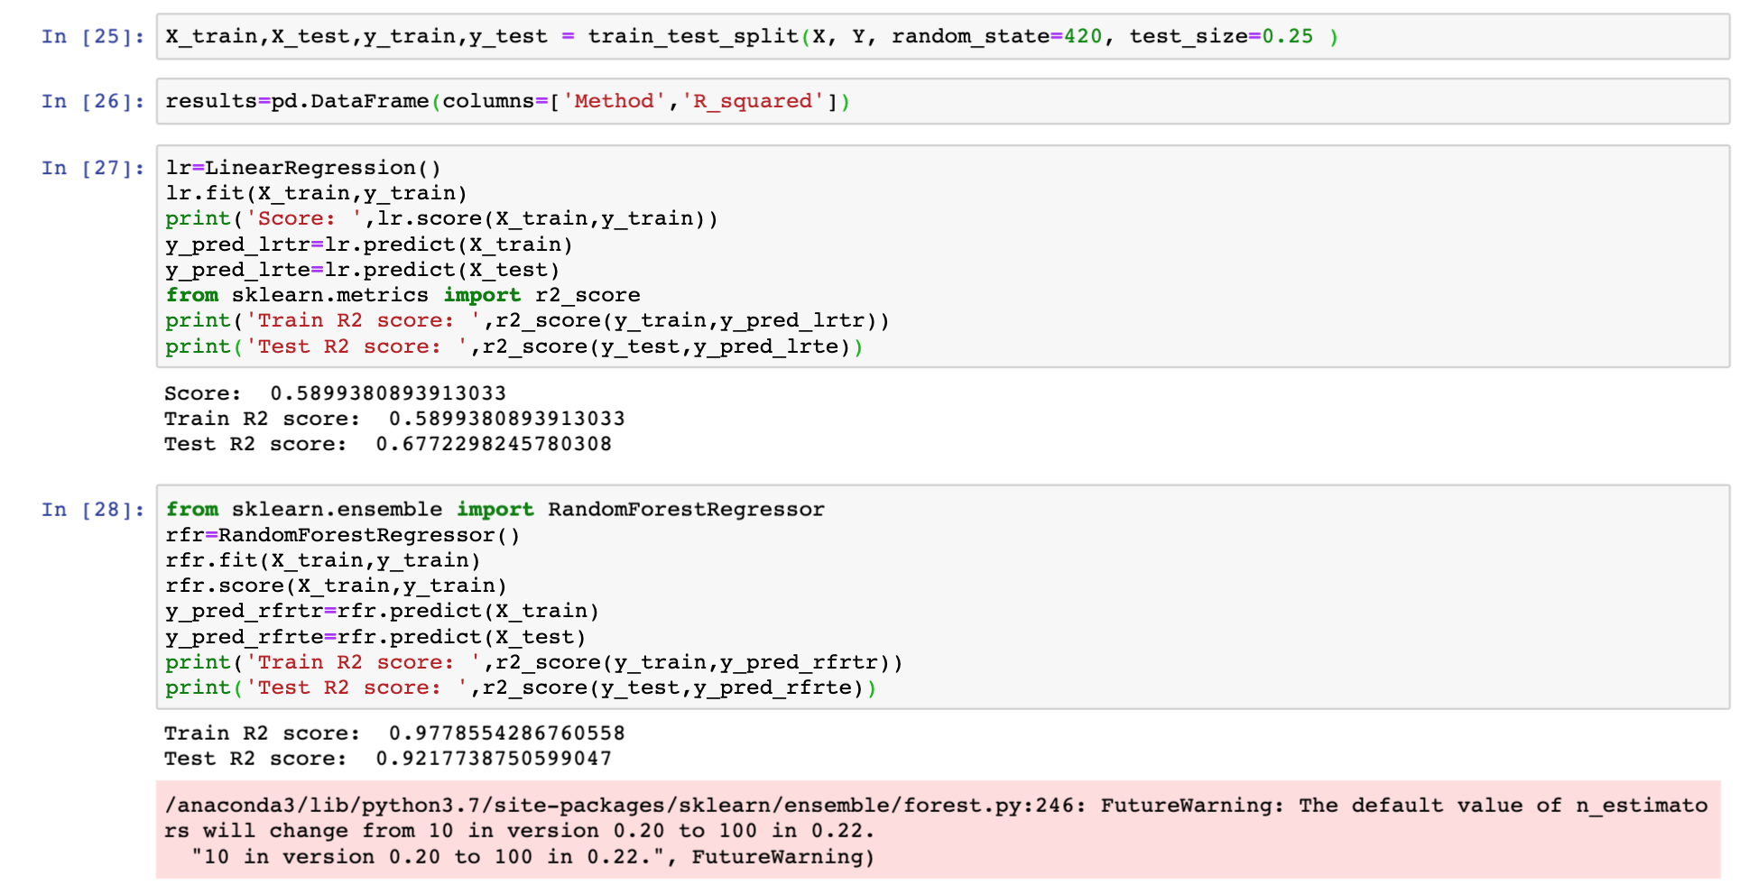
Regression Algorithms –Training and Testing

Slide 9
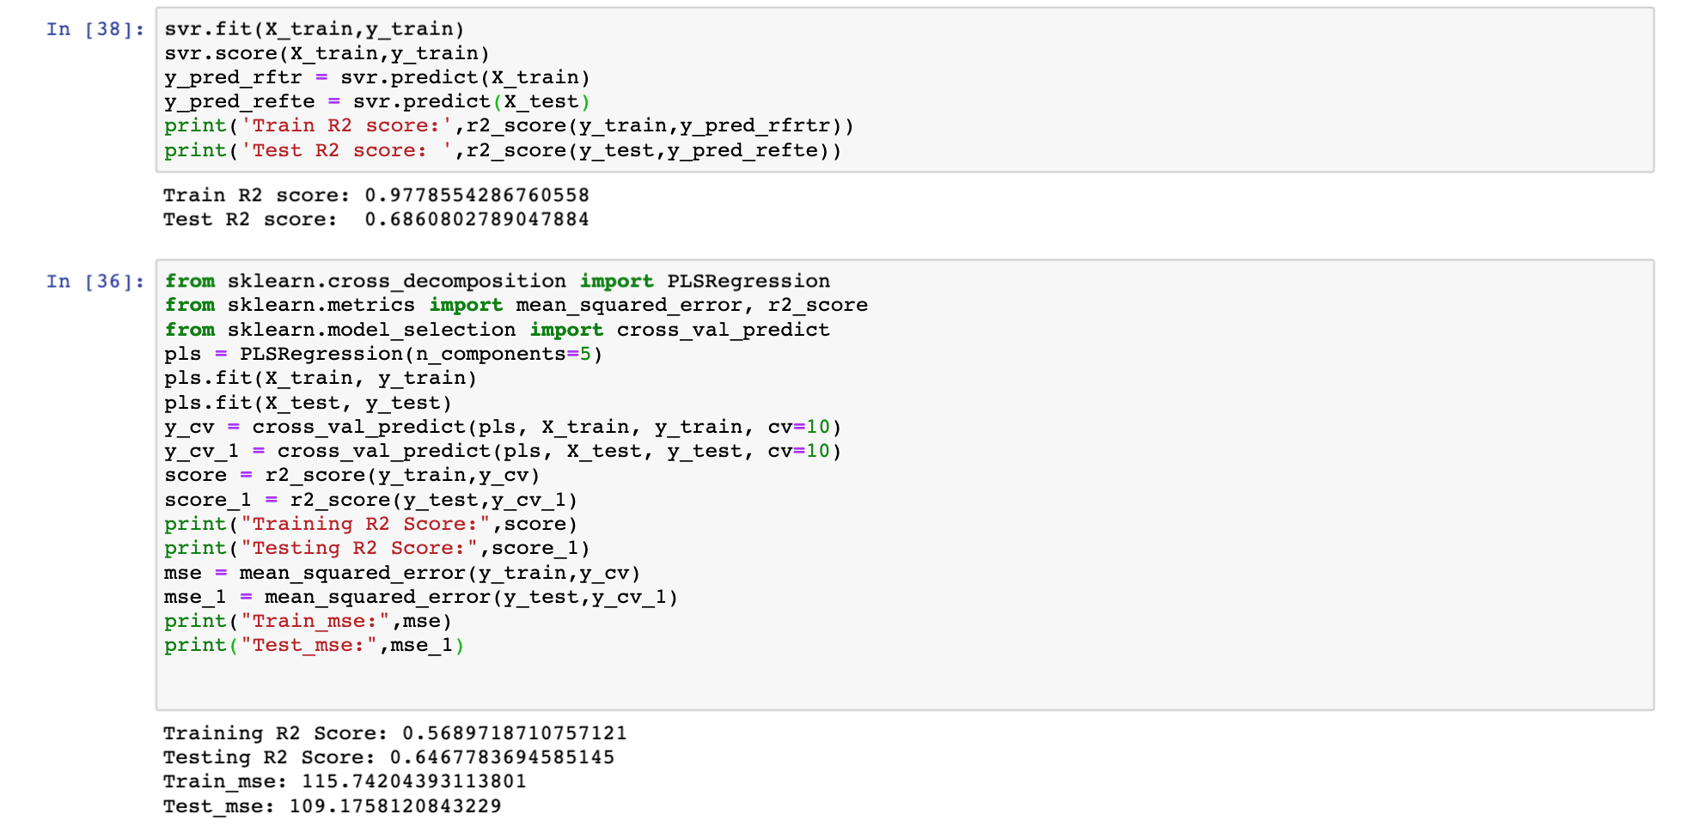
Regression Algorithms –Training and Testing

Slide 10
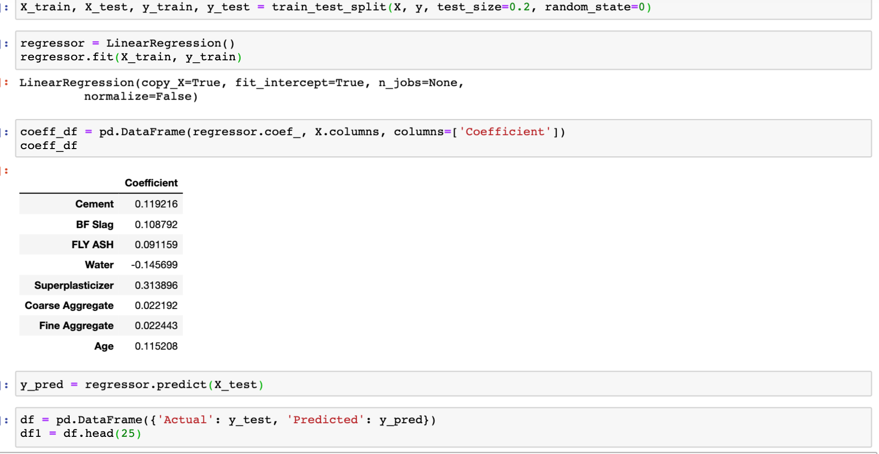
Linear Regression

Slide 11
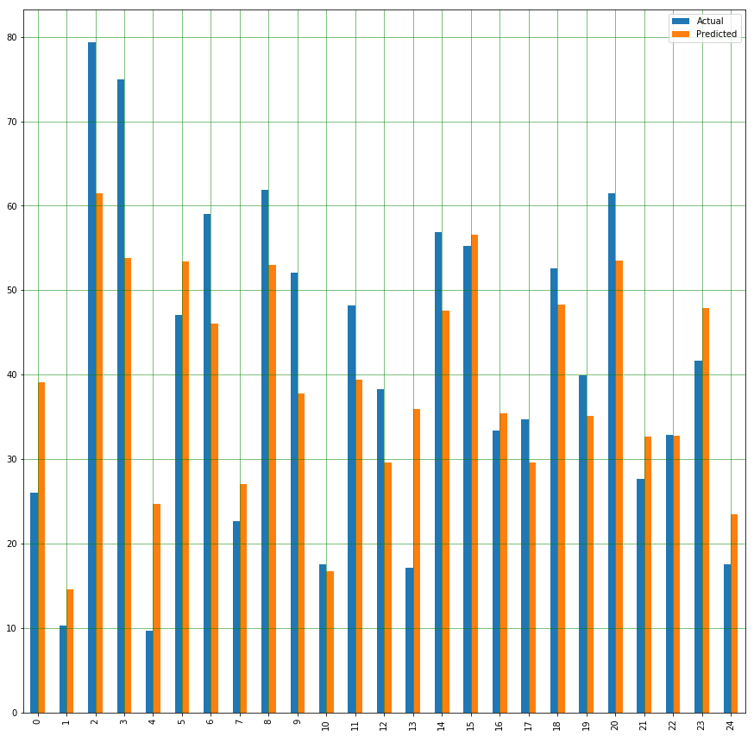
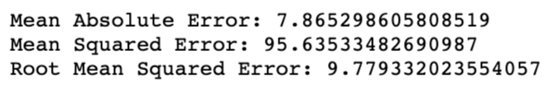
Linear Regression
Here we see that there is almost 20% difference in the predicted value to the actual value. This means that this prediction is not the most ideal. There can be many possible cases because of which this occurs, but we can confirm this with more data on same type of mixtures.

Slide 12
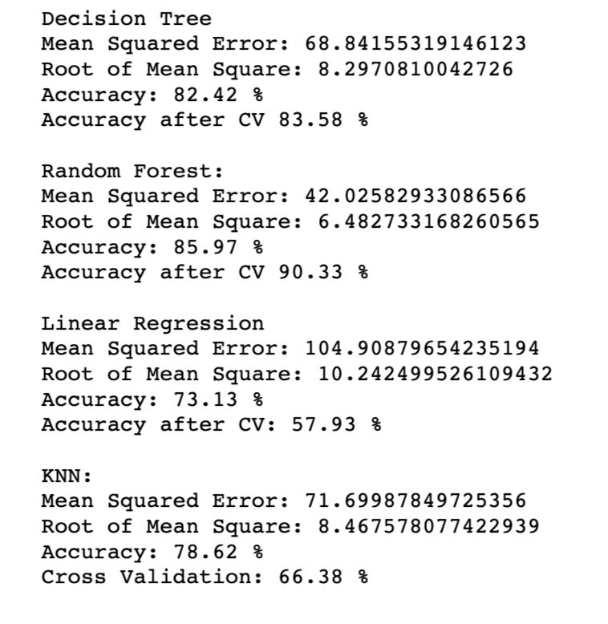
Regression Algorithms – Cross Validation
I am trying to find a relationship between the dependent and independent variables and create a prediction, testing my hypothesis with 10-fold CV.

